Slide 1
A.S.D.GOVERNMENT DEGREE COLLEGE FOR WOMEN (AUTONOMOUS) KAKINADA
DEPARTMENT OF MICROBIOLOGY
Plant Growth Promoting Rhizobacter
BY
Dr. K. Aruna
Lecturer in Microbiology

Slide 2
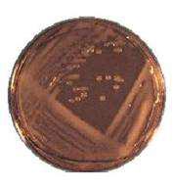
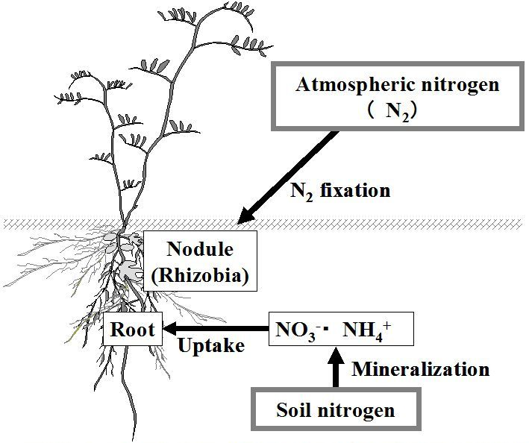
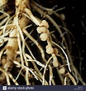
Rhizobia
Rhizobium – Leguminous plants
Sinorhizobium- Nodules on soybeans
Bradyrhizobium- Soybeans, Lotus
Mesorhizobium-Lotus
Azorhizobium

Slide 3
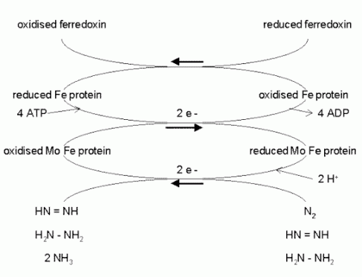
Rhizobia
Rhizobium is a soil habitat bacterium, which can able to colonize the legume roots and fixes the atmospheric nitrogen symbiotically.
They are the most efficient biofertilizer as per the quantity of nitrogen fixed concerned

Slide 4
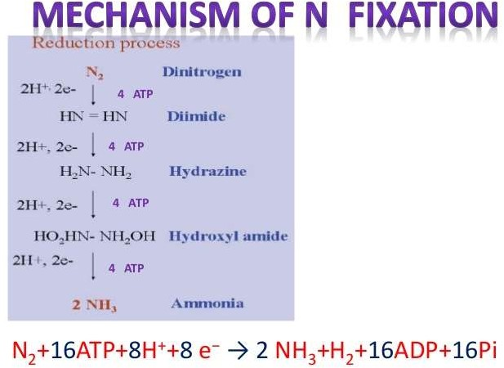
Mechanism of Nitrogen Fixation by Nitrogenase

Slide 5
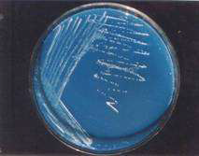
Azospirellum
primary inhabitants of soil, the rhizosphere and intercellular spaces of root cortex ofgraminaceous plants.
• They perform the associative symbiotic relation with the graminaceous plants
• The bacteria of Genus Azospirillum are N2fixing organisms isolated from the root and above ground parts of a variety of crop plants
It fixes atmospheric nitrogen at microaerophilic conditions
Fix atmospheric nitrogen non symbiotically
Bacteria produce substances like IAA, Kinetins and gibberellins.
Inoculation with seeds of sorghum, bajra and ragi may enhance the grain and fodder yields

Slide 6
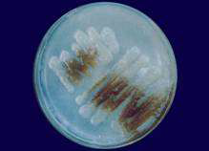
Azatobacter
Inhabitant in arable soils capable of fixing N2 (2-15 mg N2 fixed /g of carbon source) in culture media..
The bacterium produces abundant slime which helps in soil aggregation
Fix atmospheric nitrogen non symbiotically
Obligate aerobe, its enzyme called nitrogenase that catalyzes atmospheric nitrogen is oxygenic sensitive
It converts nitrogen to dimide, which converts to hydrazine, then hydrazine converted to ammonia
It increases crop yield in barley, maize.oats, potatos and sugarbeet.
It synthesizes substances like B-vitamins, IAA abd gibberellins.

Slide 7
Phosphate Solubilising Bacteria(PSM)
Several soil bacteria and fungi, notably species of Pseudomonas, Bacillus, Penicillium, Aspergillus etc.
Secrete organic acids and lower the pH in their vicinity to bring about dissolution of bound phosphates in soil.
Increased yields of wheat and potato were demonstrated due to inoculation of peat based cultures of Bacillus polymyxa and Pseudomonas
striata.
Phosphate solubilisation
Produce plant growth promoting substances
Reduce the soil Ph by producing the various organic acids.
Siderophores- iron chelating agents Ex: Pseudomonas

Slide 8
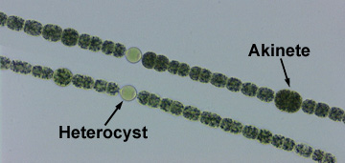
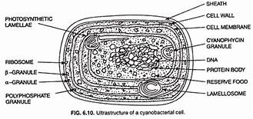
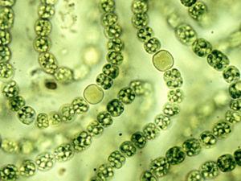
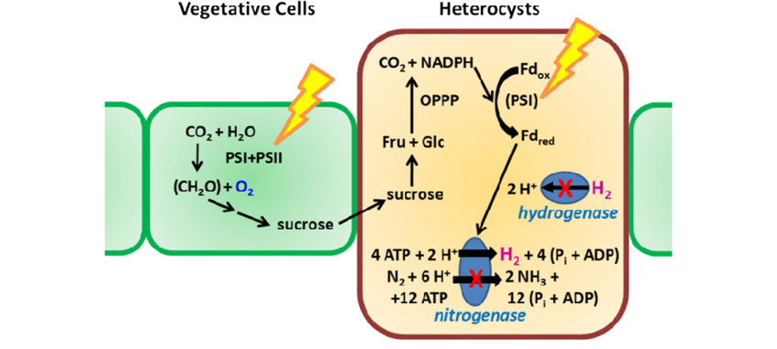
Cyanobacteria

Slide 9
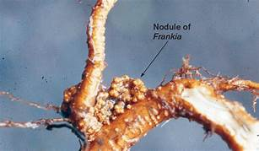
Actinorhizae(Frankia – Induced Nodulation)
Roots on non leguminous plants are modulated by an Actinomcete name Frankia. This association is called Actinorhizae.
Actinorhizae is considerable amount of Nitrogen
Frankia is filamentous, forms spores, non motile , micro aerophilic and grow symbiotic association with non-leguminous angiosperms.
Frankia produce nodules

Slide 10



